Slide 1
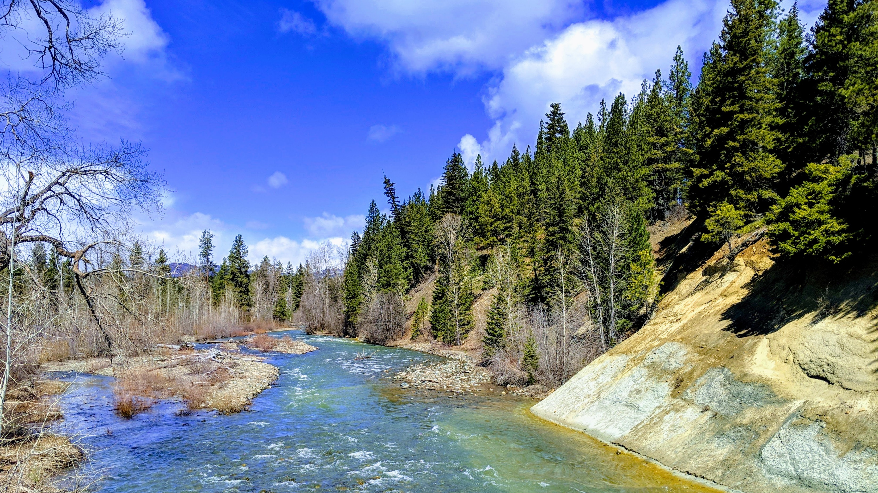
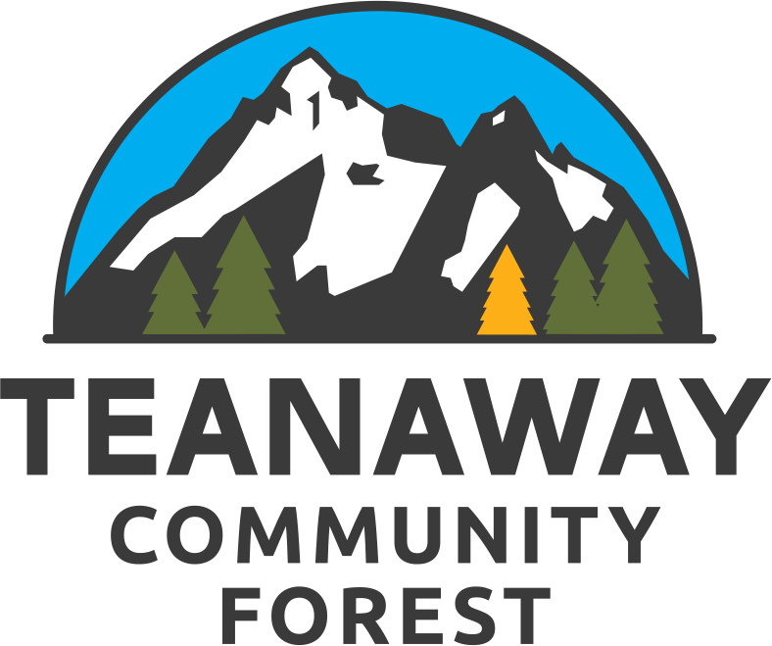
TEANAWAY COMMUNITY FOREST
Cooperative Decision-Making

Slide 2
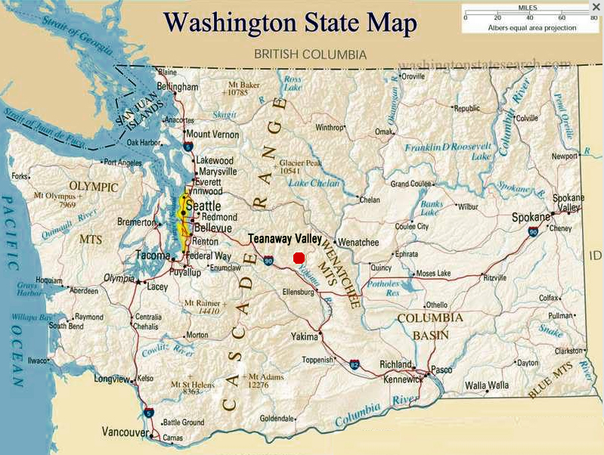
WA’s FIRST STATE-OWNED COMMUNITY FOREST:
50,241 acres
Vital headwaters
Slated for development
Acquired by state - 2013
50,241 acres
Yakima Basin Integrated Plan – water supply and climate change
Notes:
The acquisition of the Teanaway and the establishment of its management goals were initially designed to align with the Yakima Basin Integrated Plan’s climate change mitigation efforts – we know that precipitation patterns are changing, which endangers water supply, leads to more catastrophic wildfires, and affects wildlife habitat. Everything we do in the Teanaway is a direct response to the threats of climate change, while ensuring that communities can continue to enjoy the benefits of their natural resources.

Slide 3
5 BALANCED GOALS:
Water supply and watershed health
Working lands for forestry and grazing
Maintain and expand recreation
Conserve and restore vital habitat
Support strong community partnerships & engage stakeholders in land management
Notes:
Any management decisions must balance the five goals set by the legislature for the landscape. They are:
Many of these goals require expert staff to accomplish – habitat restoration projects, forestry, rangeland management, and hydrologic assessment – and that’s where agency partners are invaluable. But this is still public land, and a community forest, so public engagement in assessing data, decision making, and ongoing maintenance work is also key.

Slide 4
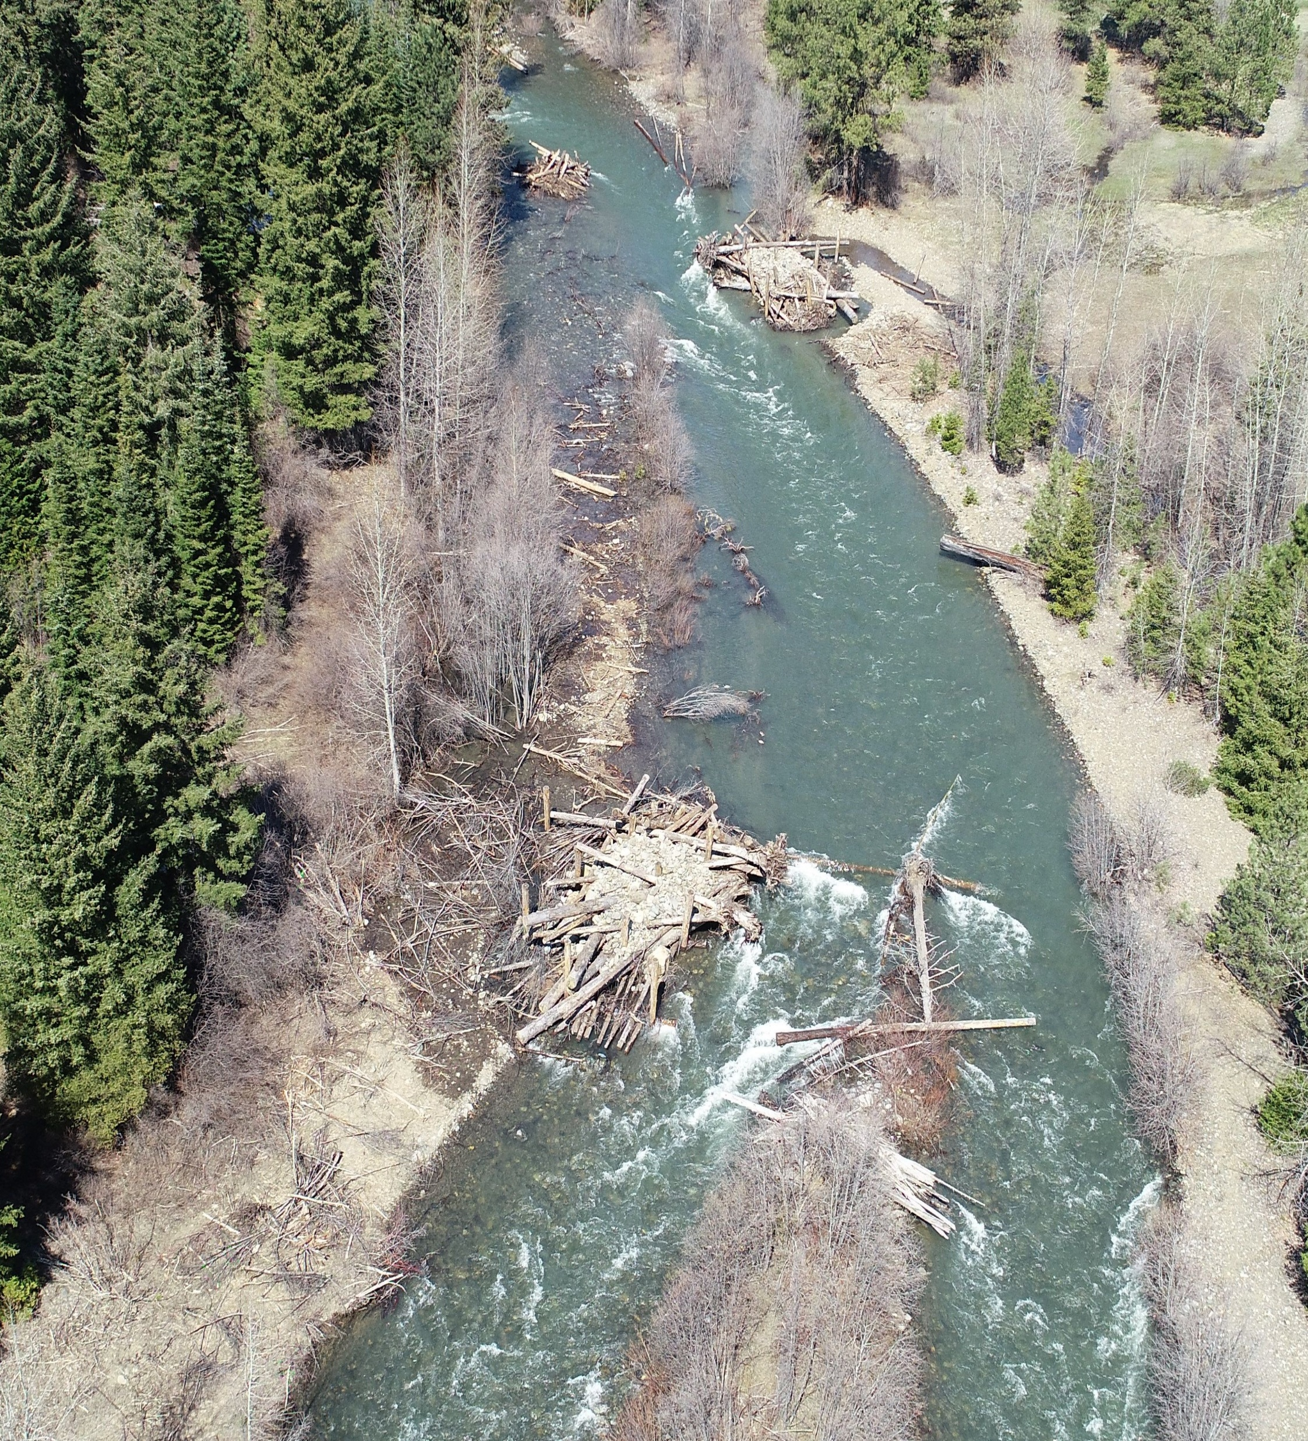
Cooperative Decision Making
Input from AC (and public) on what balanced goals looks like
Present strategies
Discussion by AC
DNR/DFW decision
Update AC
Resource implementation

Slide 5
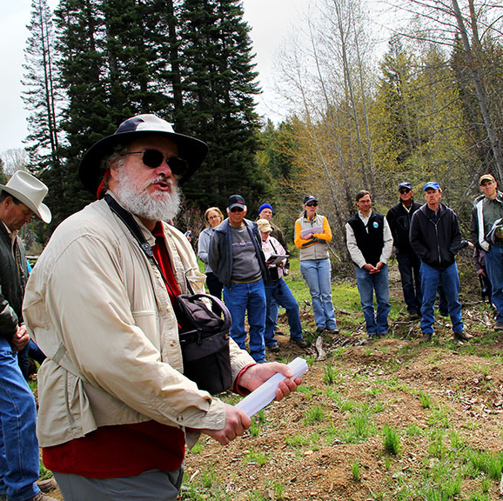
Advisory Committee
20 people
Input on WDNR & WDFW management pathways
2016-2018 – monthly
2019-now - quarterly
Notes:
Legislature also mandated creation of Advisory body to guide DNR/WDFW management
Some participants are set in stone: DNR, WDFW, Yakama Nation, Kittitas Co, Ecology
Others rotate based on capacity and current project focus: TNC, Greenway, Wilderness Federation, EMBA, WTA, BCHW, WSSA, WOHVA, etc
About a quarter of participants are nearby landowners/business owners
Two-year term, can either choose to remain or opt out at end of period. DNR then holds open applications for new seats.
Over time, makeup has shifted away from the groups who were experts in land ACQIUISITION, and has become more reflective of local communities.

Slide 6
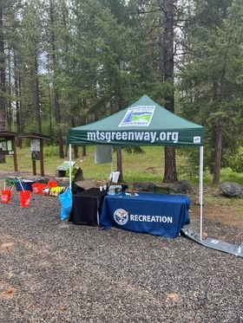
Coordinated Storytelling: G5
Interpretive Events
School Field Trips and Professional Development
Signature Volunteer Events
Legislative Advocacy
Fundraising (merch!)
Social media – information SHARING only
Spotlighting Partners
Notes:
Then there’s an added piece: making sure the broader community understands what’s going on in the Advisory Committee, and deepening their sense of ownership and engagement! To that end, DNR staff works closely with a subcommittee, called Goal 5:
Goal 5’s responsibilities include:
Advisory Committee/Outreach and Engagement group – coordinates storytelling!
Designs interpretive event series
Works with local schools to organize field trips and connect students with professional speakers
Handles logistics and execution of two ‘signature’ volunteer events during the year – one in the spring, one in the fall
Bi-annual photocontest
Boosts TCF-specific DNR news on facebook page, but has to be careful to route all questions/concerns about forest management back to DNR staff
has no authority to address public concerns but can share information
Often works with DNR local staff to approve fun posts about wildlife, landmarks, other human interest stuff
Advocates for DNR and WDFW’s budget requests in the state legislature – typically coordinates a ‘legislative day’ in Olympia in February, provides hearing testimony during budget reconciliation process, organizes collection of public statements of support, etc

Slide 7
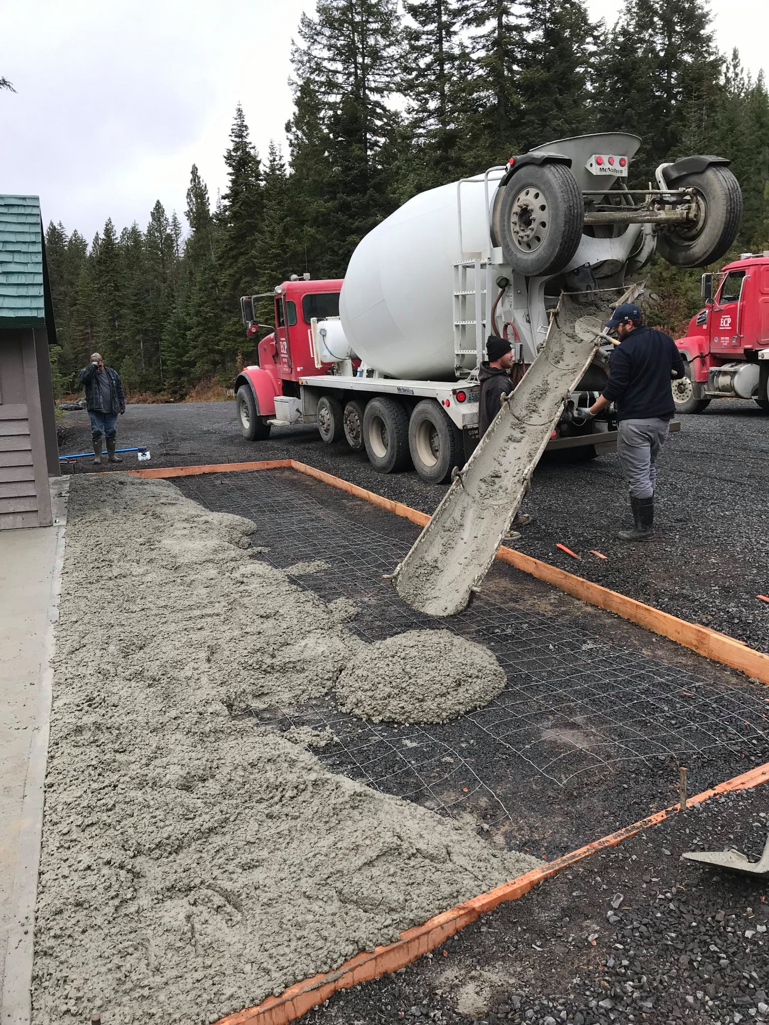
Data and Permissions: DNR
Determines Openings, Closures, Permitted Uses
Project updates
Requests for Proposals/Bids
Leases, Large Scale events, Vendor Agreements
Staff Management & Oversight
Compiles User Information, Surveys, and Statistics
Notes:
G5 must ensure the public understands that DNR is the land manager, and how to communicate with them. Whereas DNR’s responsibilities include:
Maintains the public communication line –. All questions about openings, closures, permits, allowed recreation, safety, etc, have to go through DNR.
Basically the outreach group takes the official stuff and shares it through platforms that they can manage more quickly and efficiently than DNR’s agency-wide comms process
Handles the actual watershed/forest health/land management work in partnership with WDFW, and often releases cool updates on projects, collected data, or upcoming bids
Interacts with official vendors – all the land leases, major paid events, etc, go through them
Devises the budget and oversees professional staff (biologists, foresters, rec managers, etc), then reports out to the Advisory Committee

Slide 8
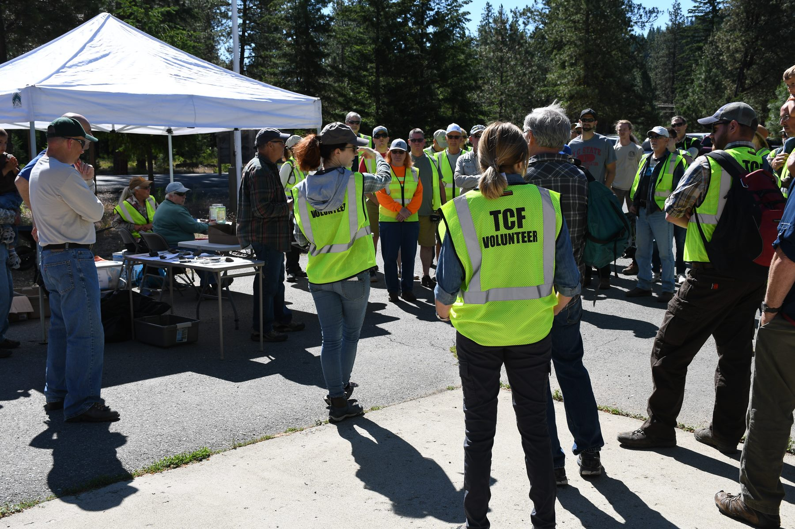
Collaborative Outcomes:
More than $100k in volunteer match hours
$150k Partner Staff match
$1m RCO grants awarded
Annual legislative advocacy program
Successfully secured $2m recurring operating funds in 2023
520,000 recorded visitors in 2020
74 Campsite facilities improved
2 year recurring interpretive programs
### students introduced to restoration techniques
Notes:
Through all of those efforts, the TCFAC is able to demonstrate successes like:

