Slide 1
Nason Ridge Community Forest Stewardship Committee Recreation and Access Planning
NWCFC Quarterly Meeting May 9th 2023

Slide 2
Timeline
2018 - Save Nason Ridge campaign
2019 - Nason Ridge Advisory Committee develops Community Forest Management Plan
2020-2022 – Western Rivers, CDLT, and Chelan County work on grant funding for acquisition
2022 – Chelan County acquires the ~4,000 acre Community Forest

Slide 3
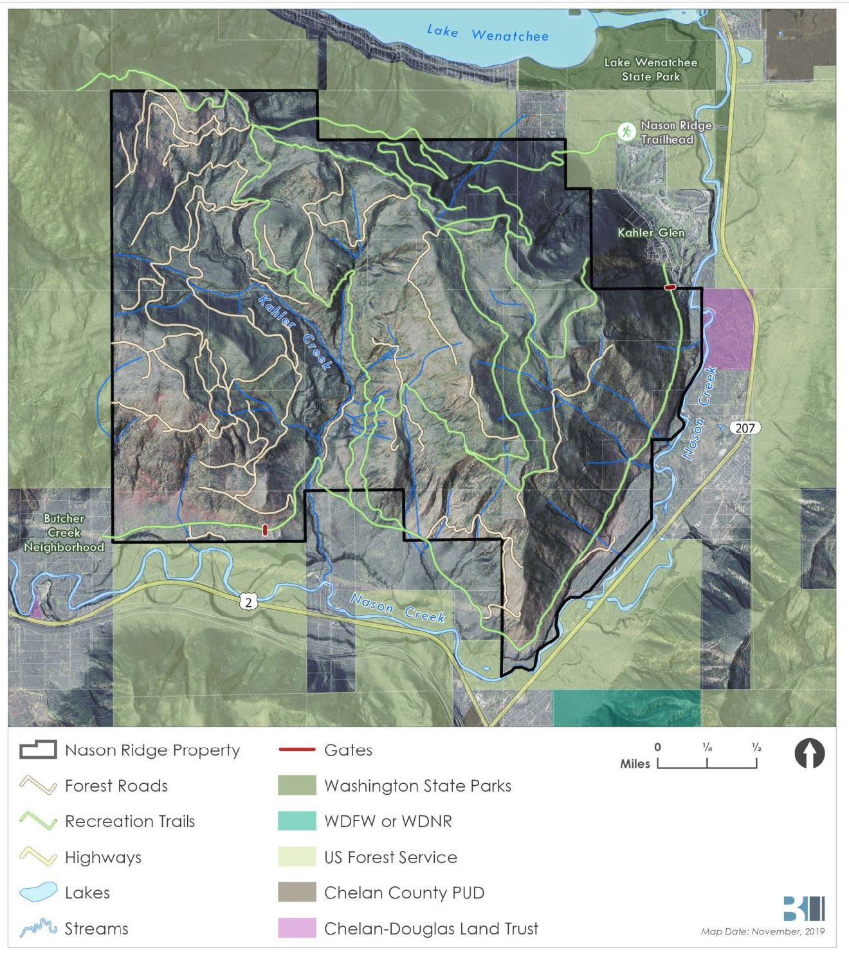
Stewardship Group

Slide 4
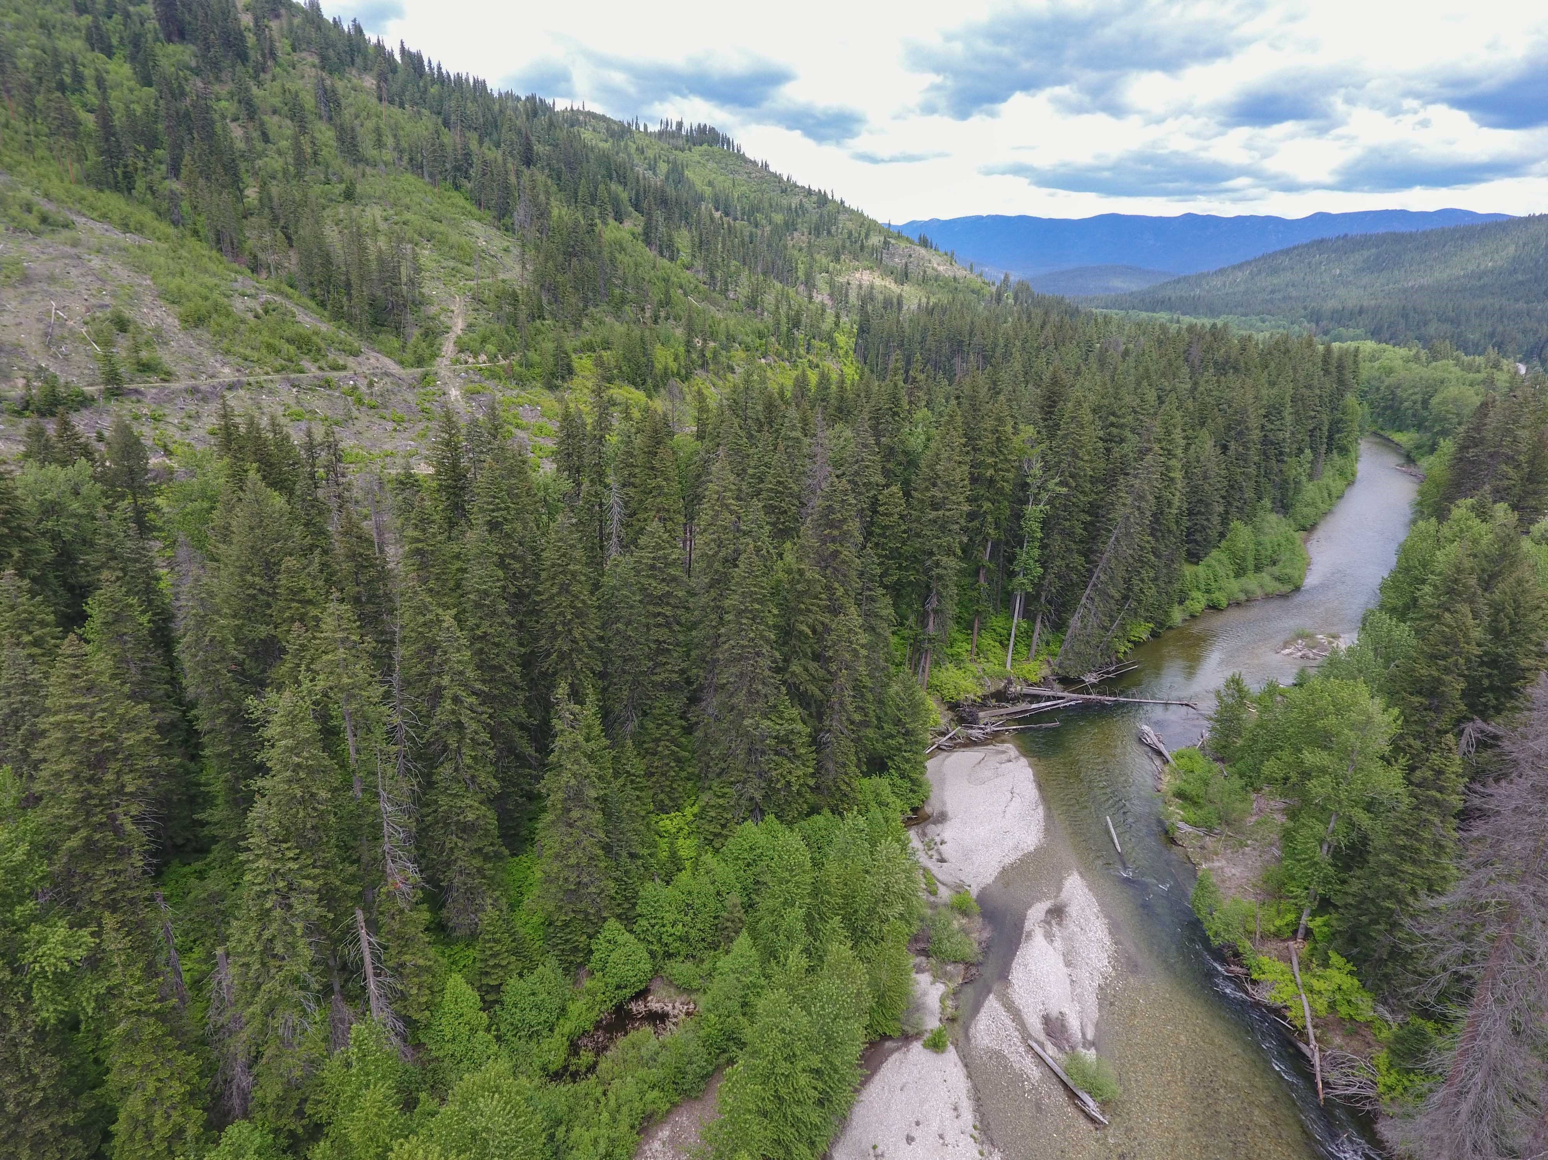
Community Forest
Management Goals
Community Benefits
Aquatic Restoration
Road Management/Sediment Reduction
Forest Health/Resiliency
Invasive Species Management

Slide 5
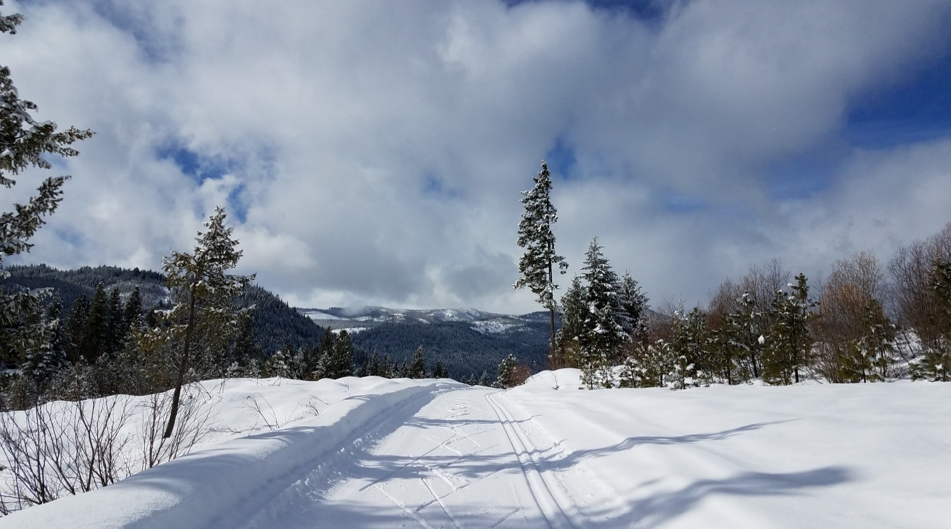
Recreation Opportunity
Public Access
Education

Slide 6
Nason Ridge Recreation and Access Objectives

Slide 10
Recreation and Access Planning Committee Meetings
Develop Recommendations Based on Objectives and Desired Opportunities
Public Review and Plan Revisions based on Stakeholder Input
Chelan County Adoption by Resolution

Slide 11
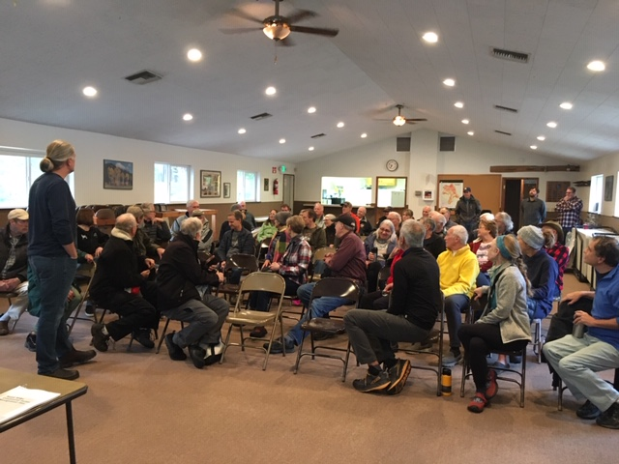
Planning Meetings
Monthly from Dec 2022- August 2023
Design charrette in October 2023
Assistance from NPS RTCA
Develop charter, vision, and desired conditions
Use Management Plan as guidance

Slide 12
Priority Recreation Topics
Parking/Access
Hunting
Signage/Interp
Trail Improvements and Development
Hiking
Biking
Ski/snowshoe
River Access
E-Bikes
Hut System
Trail Connections with Adjacent Properties (summer and winter)
Winter XC Grooming
Bird Watching/Wildlife Areas
Coulter Block Recreation Opportunities
Concessions
Enforcement

Slide 13
Nason Ridge Community Forest Recreation Planning Timeline
Topic | Meeting Type | Date* | Notes
XC Ski Trail: Grooming and Huts | Subgroup In-Person | December 12th, 2022
Access, Parking, Gates | Subgroup In-Person | January 11th, 2023 | Opportunities and challenges; access points
Access, Parking, Gates cont. | Subgroup In-Person | February 15th, 2023 | Size, Facilities, Accessibility
Subgroup work review; Leases and Economic Impact | Zoom quarterly | March 8th | Fee system, concessions, hut system
Hunting | Subgroup In-Person | April 12th, 2023 | Develop resolution for public comment
Trail Development | Subgroup In-Person | May 16th, 2023 | Zones for trail/experience types; initial trail concepts
Trail Development cont. | Subgroup In-Person | June 14th, 2023 | Loops/connections, new trail development, road decommissioning, connections with adjacent properties
Subgroup work review; Coulter Block Assessment | Zoom quarterly | July 19th, 2023 | Accesibility, signage, Coulter Block Assessment
Coulter Block Assessment | Subgroup In-Person | August 16th, 2023
Draft Plan Review/Input | Zoom quarterly | September 20th, 2023
Design Shirrette | Workshop In-person | October
Public Review and Comment | No meeting | November
Plan Adoption, Stewardship Meeting | Zoom quarterly | December
*Dates are approximate. Meetings are generally scheduled for Wednesday evenings, but may be shifted by a day or two to accommodate subgroup members

Slide 14
Vision and Goals for Access and Recreation

Slide 15
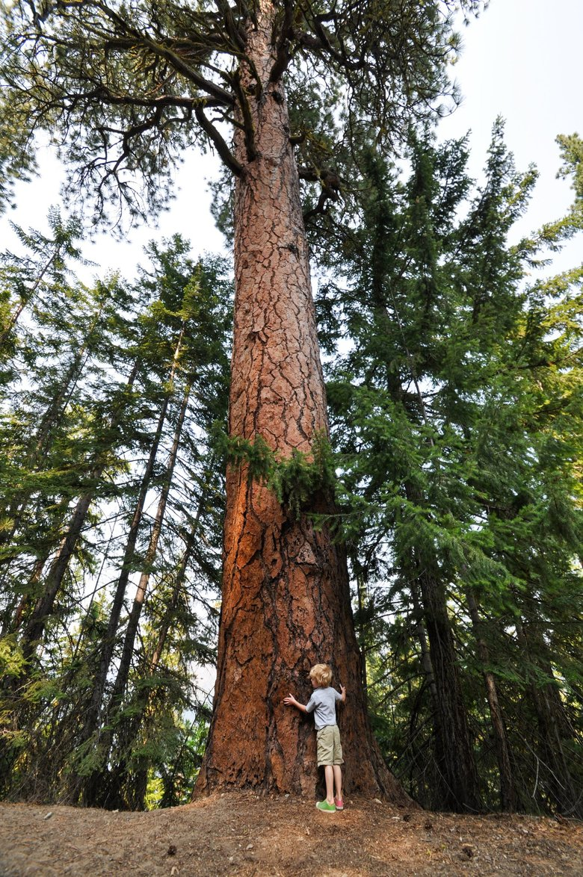
Recreation Zoning
Based on State Parks Land Classification System
Utilize existing data layers to identify areas that are appropriate for different levels of recreation development/access
‘Resource Recreation’ areas are appropriate for recreation development and will likely be utilized for other management priorities as well
‘Natural Areas’ are dedicated to wildlife habitat and ecological processes- recreation access may be appropriate for things like wildlife viewing and finding solitude

Slide 16
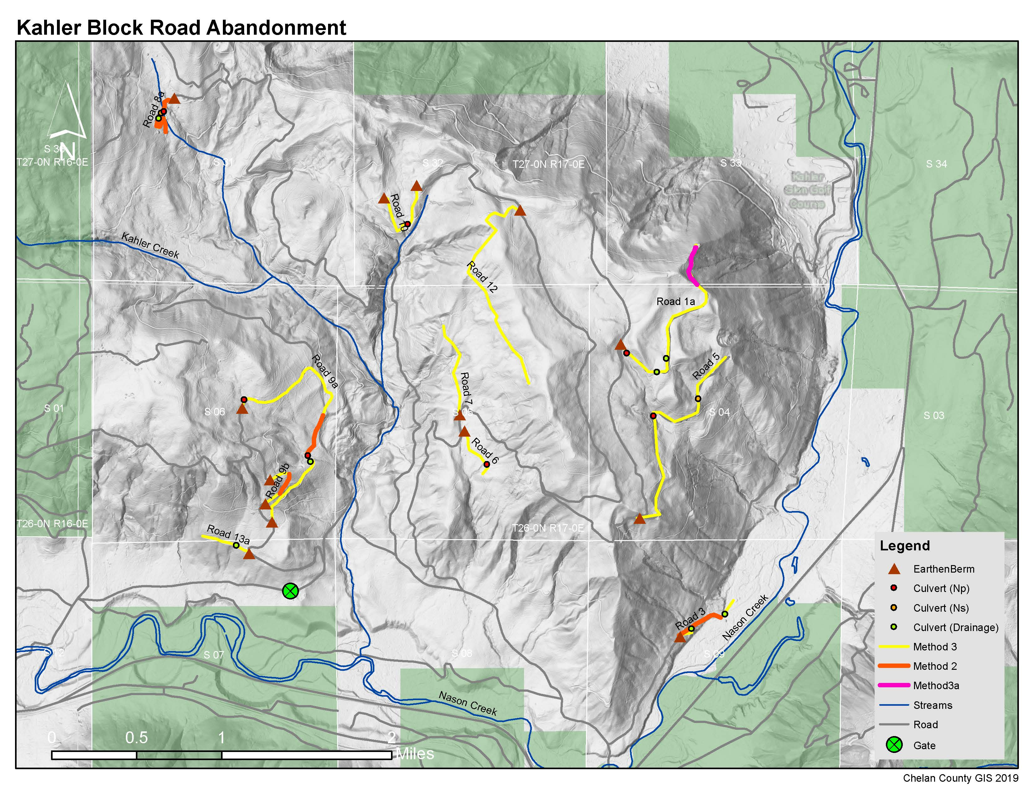
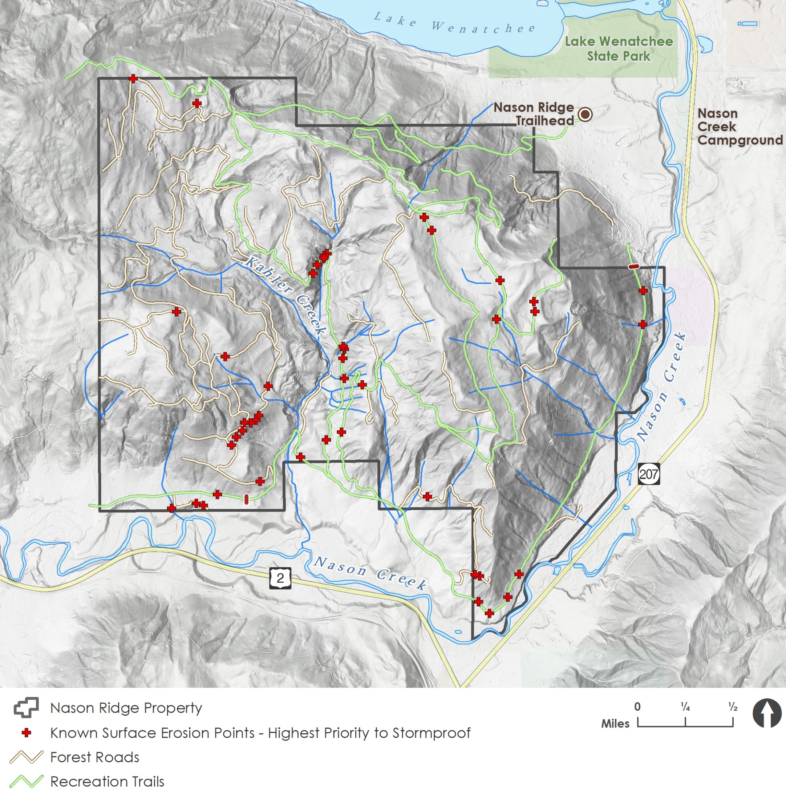
Road Decommissioning Priorities
~5 miles of road decommissioned, 13 culverts removed in 2020
Road to trail conversion recommendations as part of recreation planning

Slide 18
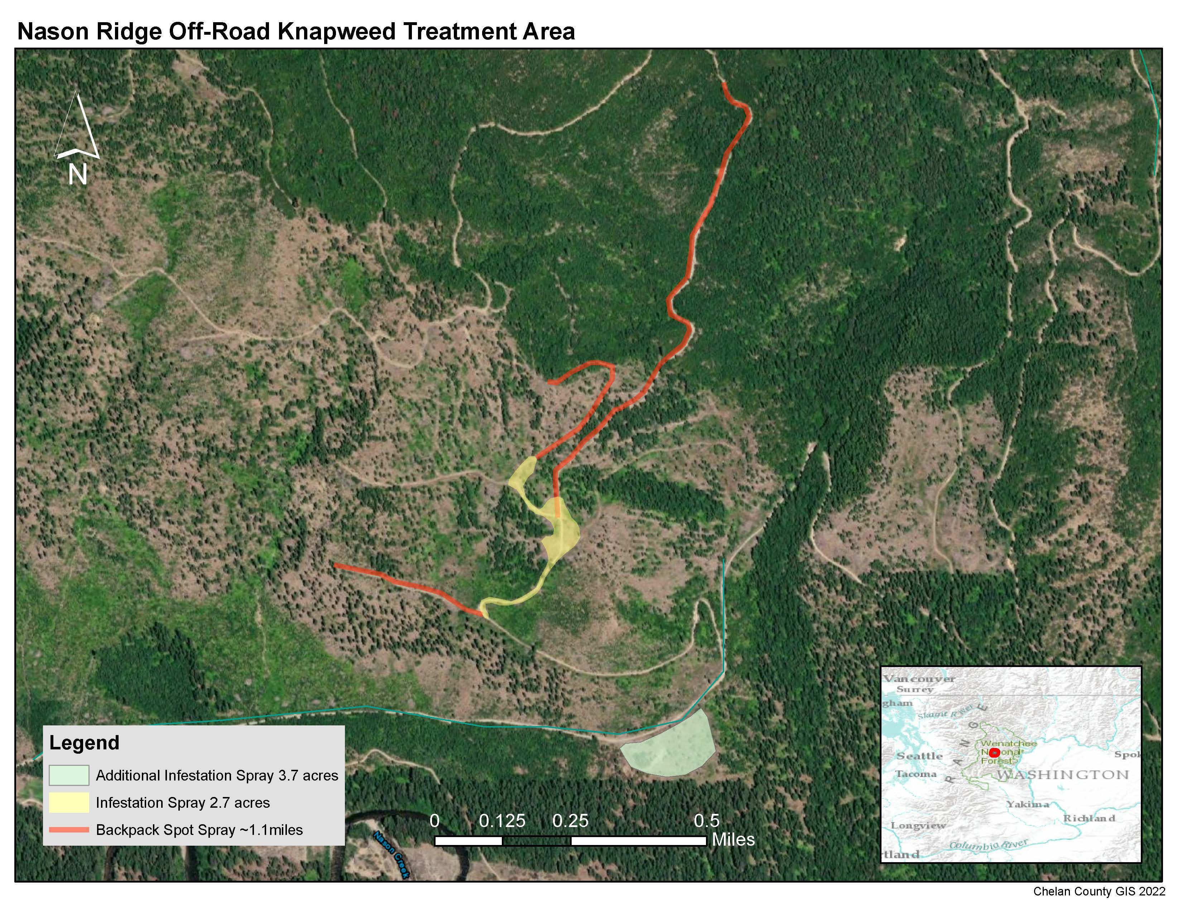
Invasive Species Management
Diffuse knapweed spray along perimeter road, summit road, and decommissioned road segments at high risk
Biocontrol planned for larger infestations
2022 and 2023 applications to treat bi-annual life cycle, funding through Department of Ecology

