Slide 1
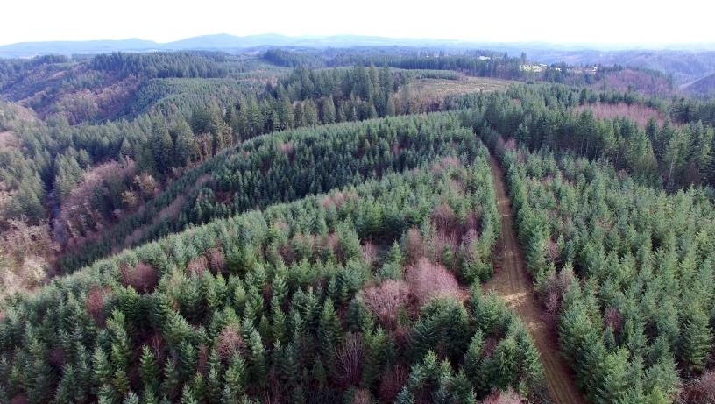
Eagle Creek Community Forest

Slide 2
The Path to Owning a Community Forest
ECCF Purchase Timeline
December 2017
18th: CSWCD and Clackamas River Basin Council discuss Eagle Creek forest property for sale by Weyerhaeuser
January 2018
5th: Dave Bugni reaches out to small group about Weyerhaeuser property to set up a meeting at Eagle Fern Park
16th: CSWCD Working Lands Committee meeting to discuss Eagle Creek property and potential project followed by CSWCD Board Meeting where a handout describing the property was provided to the board
25th: Meeting at Eagle Fern Park with CSWCD, CRBC, Dave Bugni, Clackamas County Parks, BLM to discuss goals for purchase of the 317.7 acres and larger goal of a management plan for the larger 1,375-acre area

Slide 3
The Path to Owning a Community Forest
ECCF Purchase Timeline (continued)
February 2018
21st: Tour of Weyerhaeuser property and greater contiguous BLM, PGE, and Clackamas County properties
27th: After discussion of the Weyerhaeuser property and greater contiguous forest property, board authorizes the General Manager to seek loan funding not to exceed $1.3 million and take on short-term debt for the purpose of purchasing the Eagle Creek property. District PGE and TPL plan and negotiate purchase of land from Weyerhaeuser TPL to conduct due diligence and purchase property. TPL would assist District in submitting a grant proposal to USFS for a Community Forest Grant to help offset purchase price
June 2018
29th: Submitted application for USFS Community Forest Program Grant
September 2018
18th: Awarded USFS Community Forest Program Grant

Slide 4
The Path to Owning a Community Forest
ECCF Purchase Timeline (continued)
April 2019
1st: Sale closes
May 2019
29th: USFS Community Forest Program Grant proceeds received

Slide 5
The Path to Owning a Community Forest
Purchase and Financing Details
District secures funding for Public Capital Projects from Zions Bank
February 2019 District receives $1,304,200 net proceeds from loan
March 2019 District opens escrow with Stuart Title for purchase, from TPL, in the amount of $1,293,100.50
May 2019 District receives USFS CF grant award of $550,000 used to reimburse District for purchase of property.
ECCF Capital Project Terms and Conditions
District borrowed $1,340,000 at 2.8% over 10yrs
Semiannual payments (Dec & June) Interest only and Principal + Interest, respectively

Slide 6
ECCF Management Plan
Landowner Objectives
Community Benefits
Protect property from development
Economically Sustainable
Environmental
Educational
Recreational
Economic
Recreation
Environmental
Educational

Slide 7
Eagle Creek Community Forest Advisory Committee Affiliations
Clackamas Soil and Water Conservation District staff and board
Neighbors within the Communities of George, Estacada, and Firwood/Dover
Friends of Eagle Creek
Clackamas County Parks & Forests
Oregon Department of Fish and Wildlife
Oregon State University Extension - Forestry
Portland General Electric
Clackamas River Basin Council
Metro

Slide 8
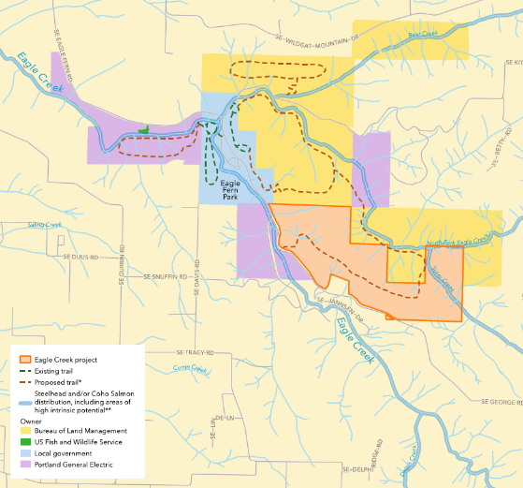
ECCF Management Plan
Conceptual Public Access
Trail connection to BLM, PGE and Eagle Fern Park

Slide 9
ECCF Management Plan
Management Zones
Active management areas
221 acres 69%
Late-successional forest
70 acres 22%
Aesthetic buffer on George Road
15 acres 5%
Steep-slope habitats
12 acres 4%

Slide 10
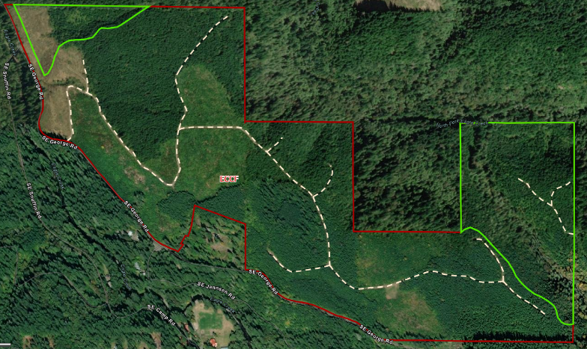
ECCF Management Plan
Late-successional Forest
70 acres 22%

Slide 11
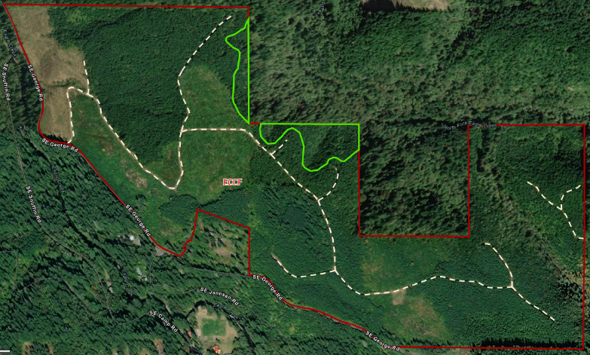
ECCF Management Plan
Steep-slope Habitat
12 acres 4%

Slide 12
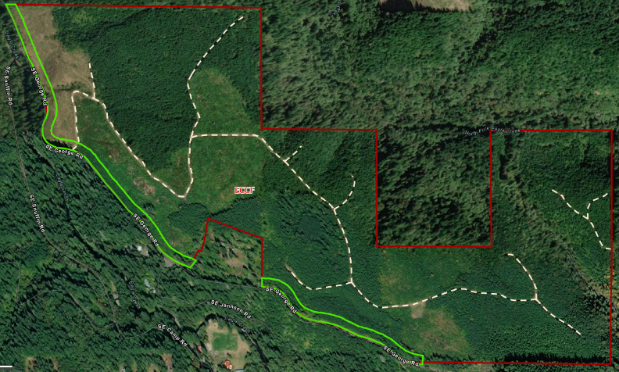
ECCF Management Plan
Aesthetic buffer on George Road
12 acres 4%

Slide 13
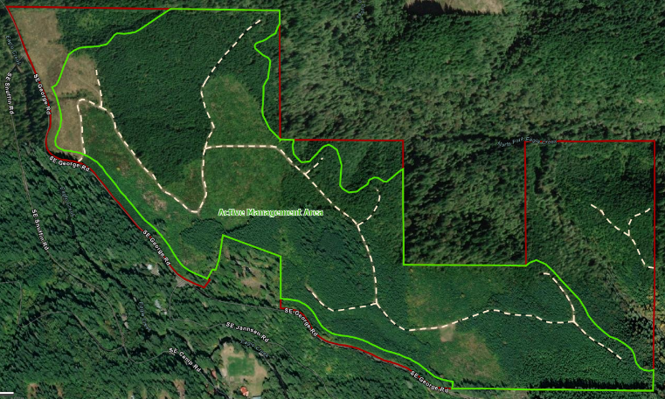
ECCF Management Plan
Active management area
221 acres
69%

Slide 14
ECCF Management Plan
Active management area
Even-aged
150 acres
Small scale regeneration harvests 2 to 10 acres
70-year target rotation age
Uneven-aged
72 acres
Partial cutting to stimulate natural regeneration
Establish at least 3 different age classes
Creates a mosaic imitating natural disturbance

Slide 15
ECCF Management Plan
Adaptive Management

Slide 16
Management Activities

Slide 17
Management Activities August 2019 Road Brushing and Mowing 2.4 Miles

Slide 18
Management Activities August 2019 Road Brushing and Mowing

Slide 19
Management Activities August 2019 Spur Clearing

Slide 20
Management Activities August 2019 Spur Clearing 0.6 Miles

Slide 21
Management Activities August 2019 Spur Clearing

Slide 22
Management Activities August 2019 Road Brushing and Mowing
1.8 miles mowed
4 hours
$710
2.4 miles brushed
87 hours
$4,874
0.6 miles masticated
5.5 hours
$1,520
Total Cost
$7,104

Slide 23
Management Activities October 2019 Weed Treatment
2.4 miles of roadbed treated
18 acres spot sprayed
Total Cost
$3,455

Slide 24
Management Activities November 2019 Slash Treatment

Slide 25
Management Activities November 2019 Slash Treatment

Slide 26
Management Activities November 2019 Slash Treatment 56 hours $2,280

Slide 27
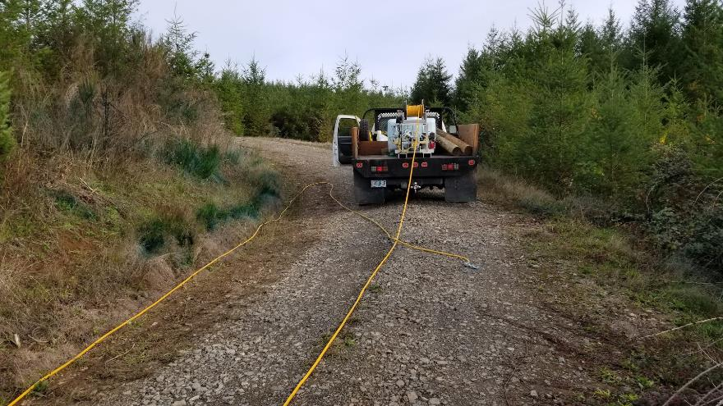
Management Activities Annual Roadside Weed and Roadbed Treatments 2.4 miles

Slide 28
Management Activities May 2021 Stand 3 Bigleaf maple Suppression
10 acres treated
22 hours
$1,235
Suter Creek conifer planting release
10 hours
$405

Slide 29
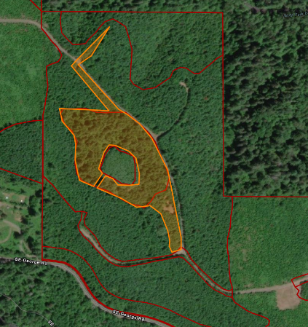
Management Activities December 2021 Stand 11 and Stand 4 Fuels Treatment
8 acres treated
64 hours
$2,880

Slide 30
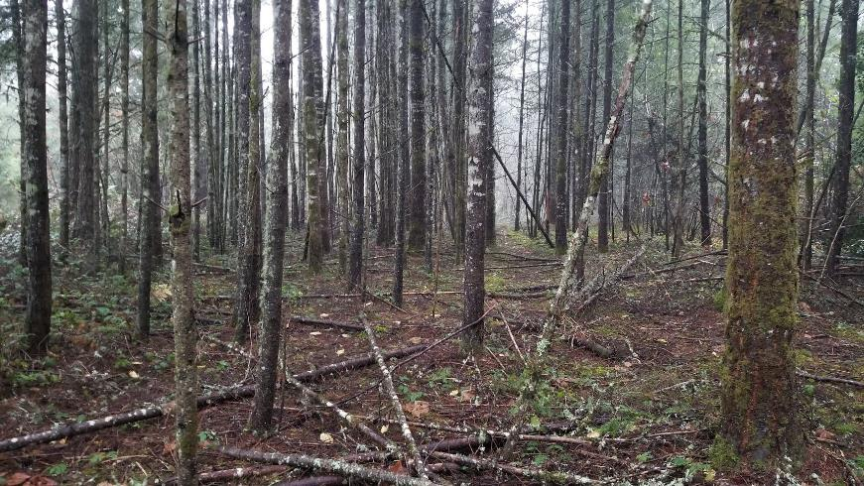
Management Activities December 2021 Stand 11 and Stand 4 Fuels Treatment

Slide 31
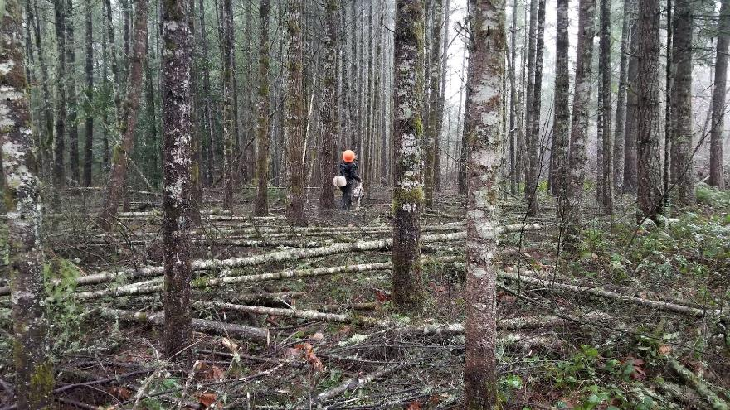
Management Activities December 2021 Stand 11 and Stand 4 Fuels Treatment

Slide 32
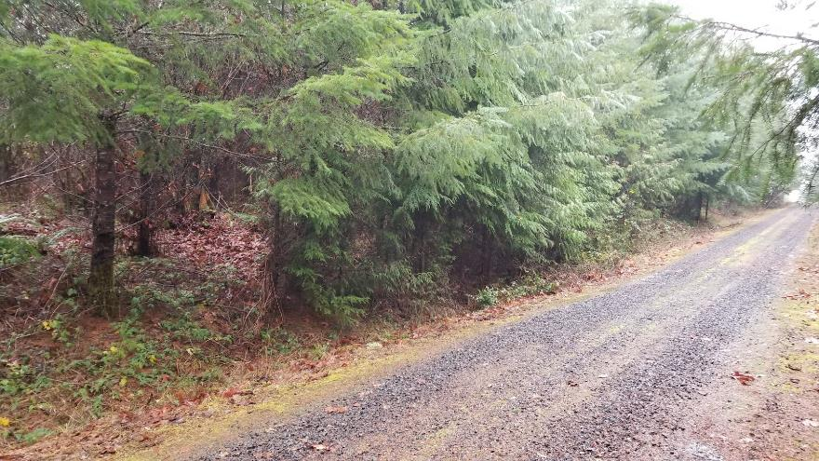
Management Activities December 2021 Stand 11 and Stand 4 Fuels Treatment

Slide 33
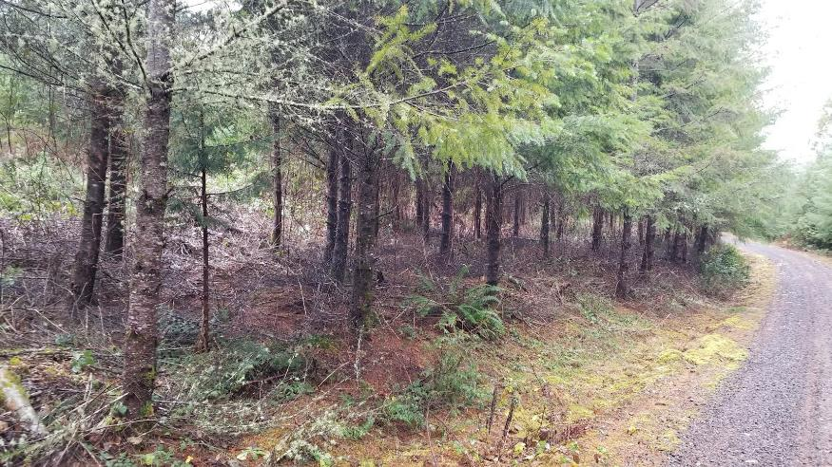
Management Activities December 2021 Stand 11 and Stand 4 Fuels Treatment

Slide 34
Management Activities January 2022 Stand 3 YST and Release 48 acres

Slide 35
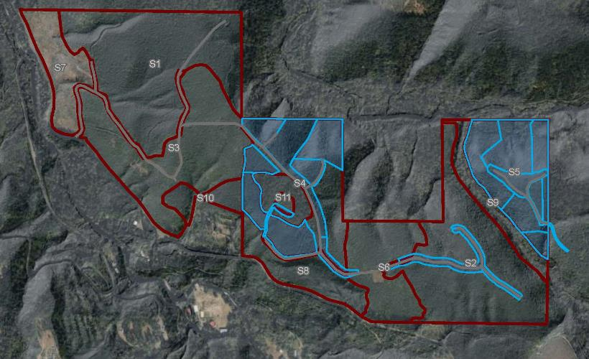
Management Activities October 2023 Stand 4 and 5 Fuels Treatment 67 acres

Slide 36
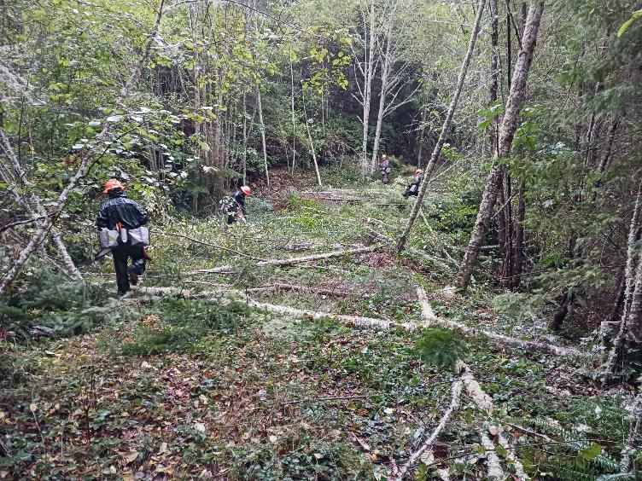
Management Activities October 2023 Stand 4 and 5 Fuels Treatment 67 acres

Slide 37
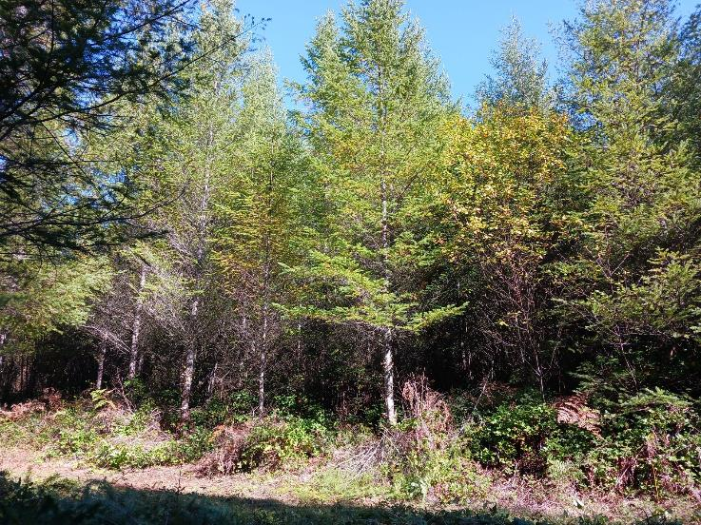
Management Activities October 2023 Stand 4 and 5 Fuels Treatment 67 acres

Slide 38
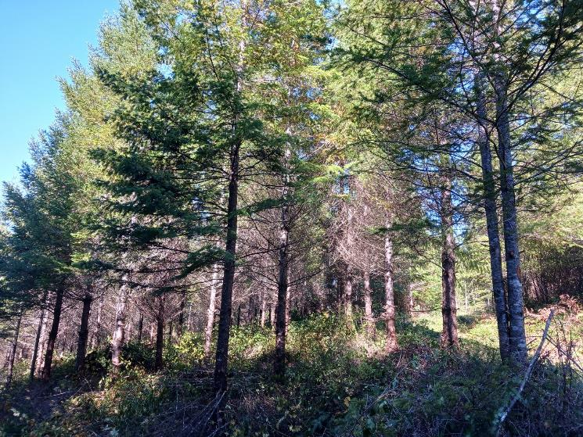
Management Activities October 2023 Stand 4 and 5 Fuels Treatment 67 acres

Slide 39
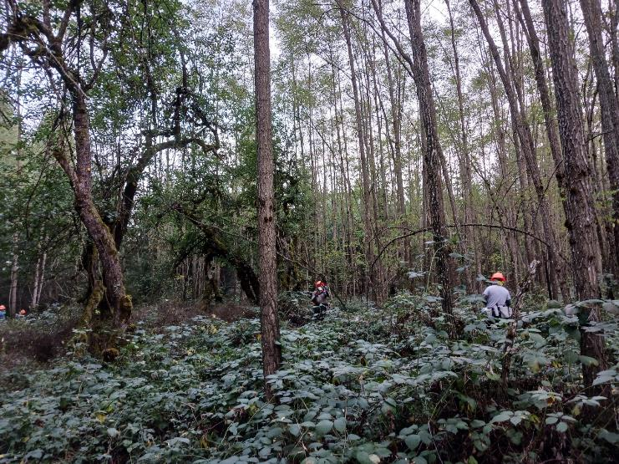
Management Activities October 2023 Stand 4 and 5 Fuels Treatment 67 acres

Slide 40
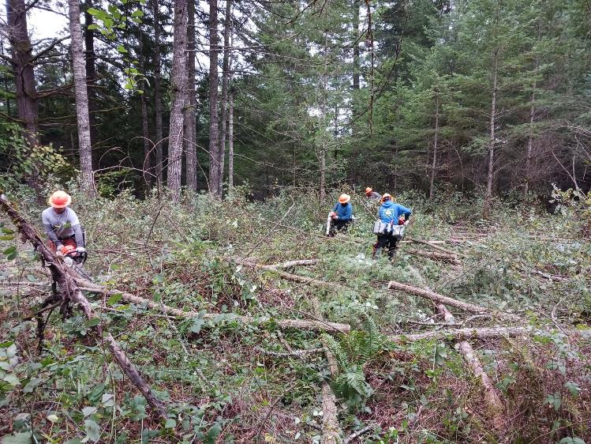
Management Activities October 2023 Stand 4 and 5 Fuels Treatment 67 acres

Slide 41
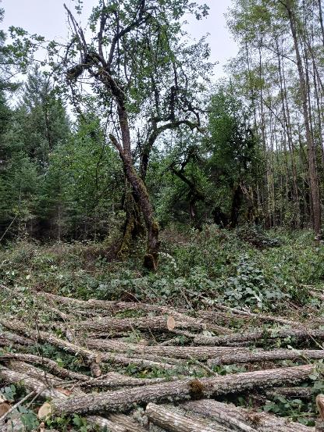
Management Activities October 2023 Stand 4 and 5 Fuels Treatment 67 acres

Slide 42
Management Activities Summary
FY20 Total = $13,089
CSWCD
$13,089
Staff time 90 hours
FY21 Total = $10,798
CSWCD
$3,789
Staff time 120 hours
Suter Creek Fish Habitat Restoration Phase 4
$7,000
FY22 Total = $7,180
Supplies/Other
$1,300
Stand 11, 4 Fuels Treatment
$2,880
Invasive Control
$3,000
Staff Time
120 hours

Slide 43
Management Activities Summary
FY23 Total = $8,200
Stand 3 YST
$5,200
Road Clearance Limbing
$3,000
Staff Time
120 hours
FY24 Total = $41,500
Stand 4 and 5 Fuels Treatment
$39,000
Invasive Control
$1,500
Staff Time
120 hours

Slide 44
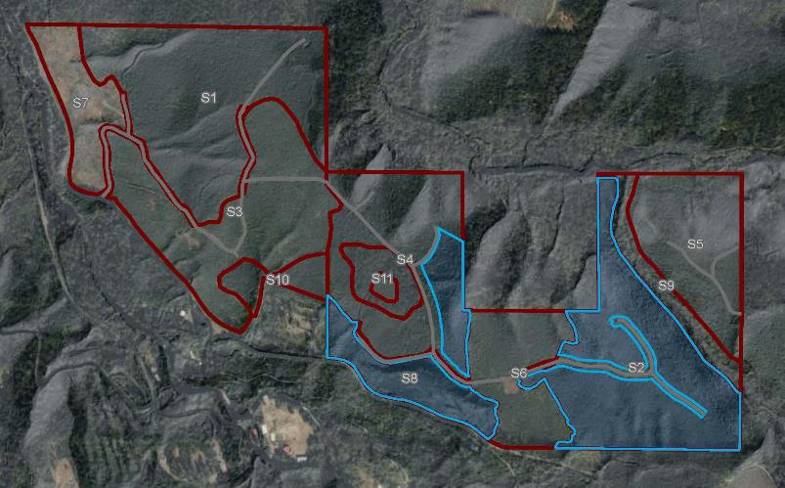
Management Activities October 2024 Stand 8 and 2 Fuels Treatment 72 acres

Slide 45
Administration and Ongoing Stewardship
Cost Estimates for Ongoing Stewardship
2019 - 2021 Costs for minimum management
Vegetation management cost including weed control, slash treatment, road clearing and selective species removal – Approx. $25,000
Staff cost for weed control, contractor oversight, administrative activities, and other tasks – Approx. $34,000 (likely underestimated)
Other costs
Equipment (shared between CSWCD HQ and ECCF) - $11,500
Vehicle wear, insurance, garbage cleanup, and misc. – minimal costs
Minimum annual custodial maintenance estimate: $7,000 - $10,000

Slide 46
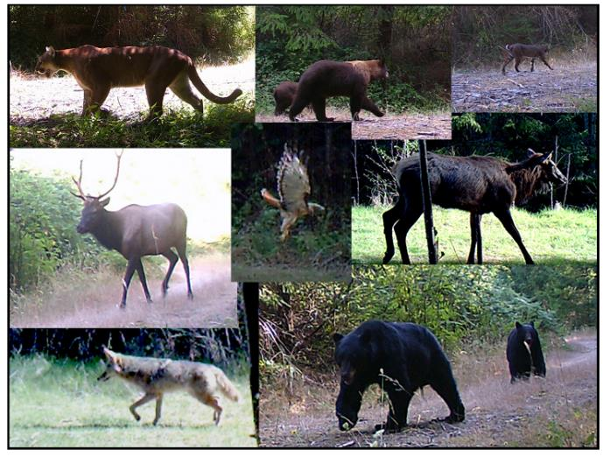
Some of our local residents!

Slide 47
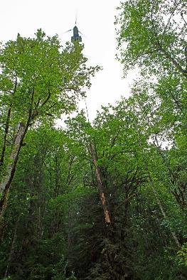
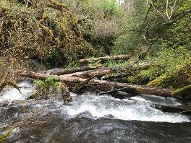
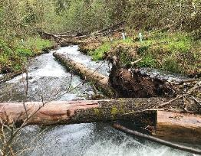
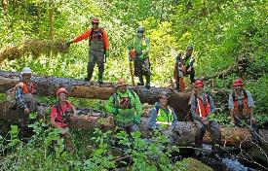
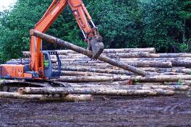
Restoration Work Along Eagle Creek and its Tributaries
Implementation occurring at ECCF on Suter Creek in 2020 as part of the ongoing series of Eagle Creek habitat projects

Slide 48
Restoration Work Along Eagle Creek and its Tributaries

Slide 49
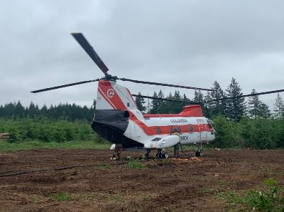
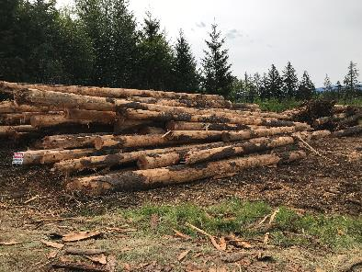
Restoration Work Along Eagle Creek and its Tributaries
Helicopter placement of additional engineered log jams
District has committed ECCF as staging area for logs/equipment

Slide 50
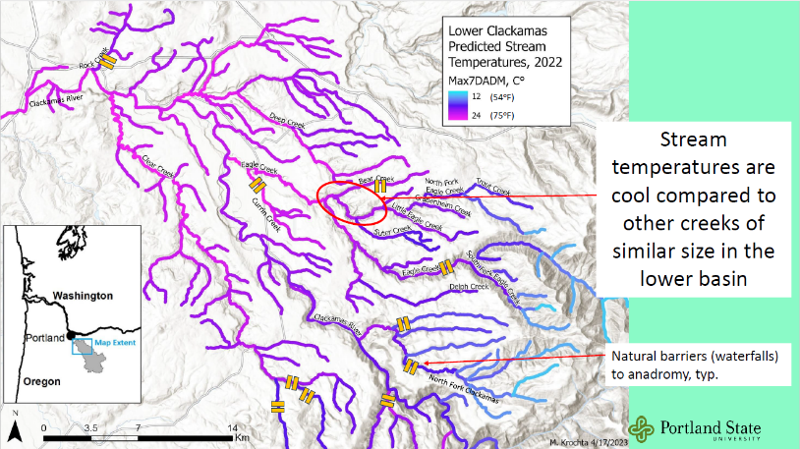
Eagle Creek Stream Temperature Monitoring

Slide 51
Friends of the Eagle Creek watershed
https://www.eaglecreekfriends.org/projects-activities
https://sites.google.com/pdx.edu/clackamas-stream-temp-project/

Slide 52
The Future of the Community Forest – Strategic Planning
What will the next 3-5 years hold at the forest?
Develop more detailed short-and-long-term management and harvest plans that reflects the values of the community and that at a minimum cover the costs of program and services.
ECCF planning will continually engage community residents and partners in an open, collaborative, and inclusive process to solidify support.
Demonstrate sustainable forestry practices and fuels reduction to Clackamas County small woodland owners
Develop relationships that allow us to explore recreational use of the forest

Slide 53
The Future of the Community Forest – Strategic Planning
Other objectives for more detailed consideration:
Climate impacts to forest resilience and opportunities for carbon sequestration
Expanding unified management plan outside of ECCF property lines
Equity based access and outreach

